Slide 1
Hydroelectric Power
By: Taylor, Justin, and Darby

Slide 2
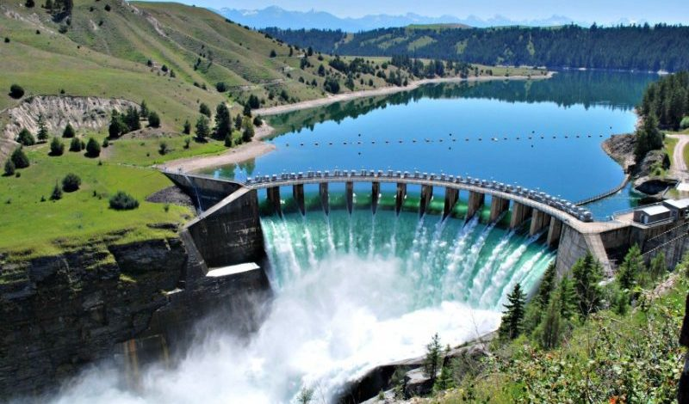
What is hydroelectric power?
Hydropower or hydroelectricity refers to the conversion of energy from flowing water into electricity.

Slide 3
Hydroelectric Power
Advantages
Disadvantages
Provides clean renewable energy
Can be used as long as the water cycle the continues
Once started more affordable
Dams act as flood control
Affected by drought
Expensive to build hydroelectric plants
Affect the ecosystem of body of water
Methane emitted to the atmosphere
Lower water quality
Notes:
bbb

Slide 4
Primary Source:
Water

Slide 5
Water Cycle Review

Slide 6
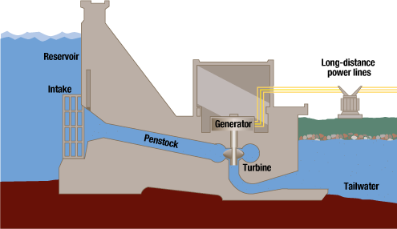
Method of Processing the Power

Slide 7
Sankey Diagram
80-90%
mg h
5-15%

Slide 8
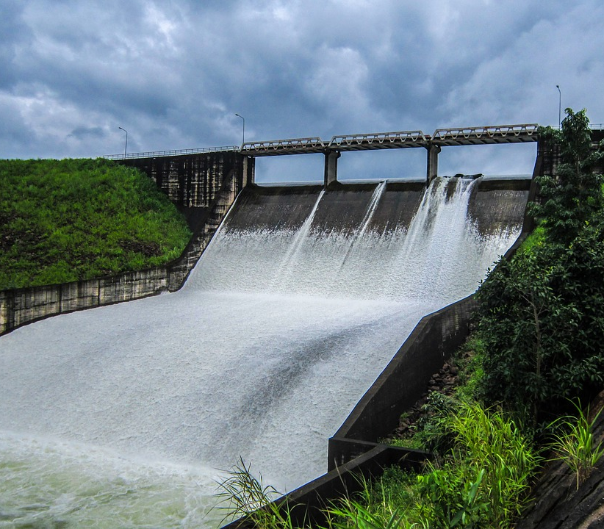
Why hydropower?
Effective and efficient compared to other renewable sources
Produce clean energy
Continuous as long as there is a water cycle
Expensive to build, but cheap to maintain
Flood control
Most of the disadvantages can be fixed

Slide 9
Important hwk info:
P=pQgh
Q= v/ t
p=m/v
Ep=mgh

